Slide 1




Phishing Detection
Nathan Poch
Masters in Cyber Security
Maurisa Dacosta
Masters in Computer Science
Rodrigo Arguello
Masters in Computer Science

Slide 2

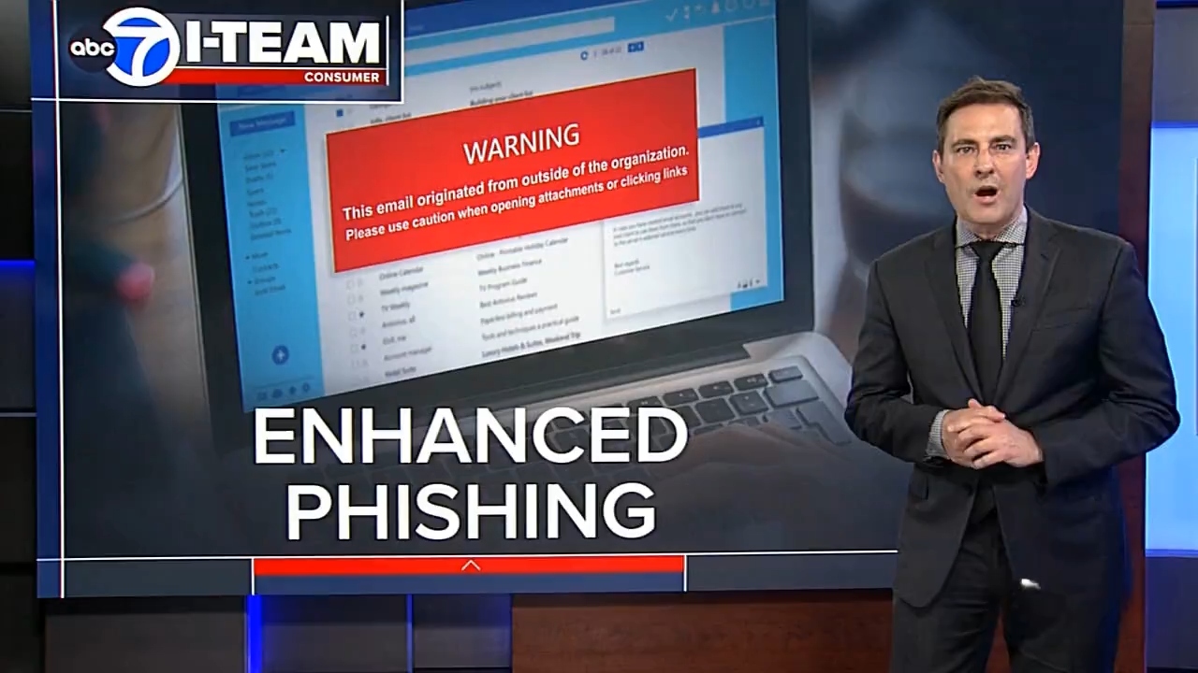
Phishing in the Headlines: Why Smarter Detection Matters
Notes:
News Stories that represent the prevalence of phishing

Slide 3
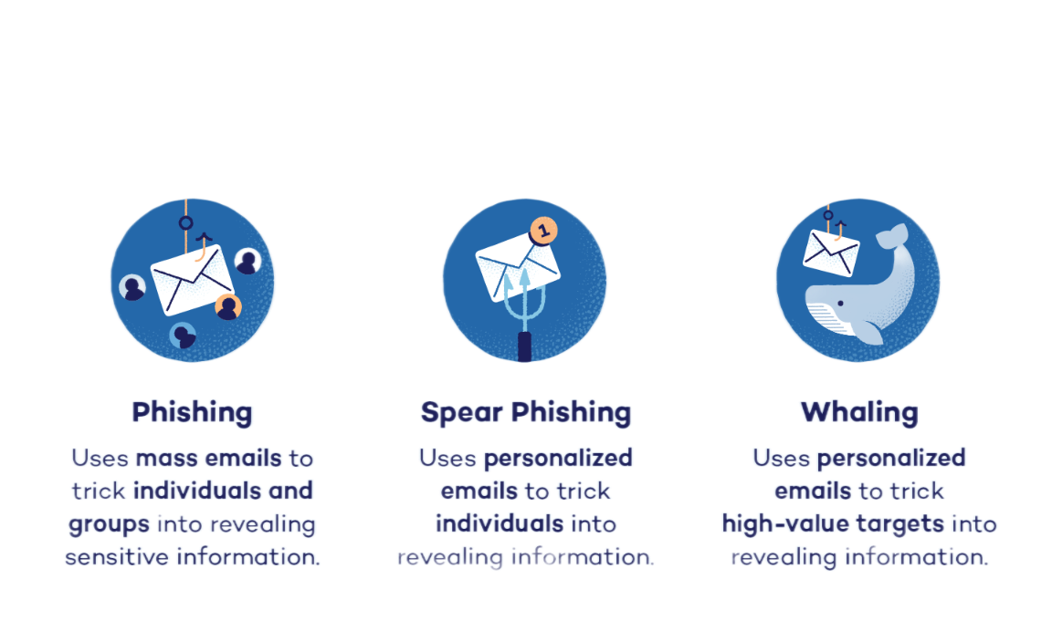
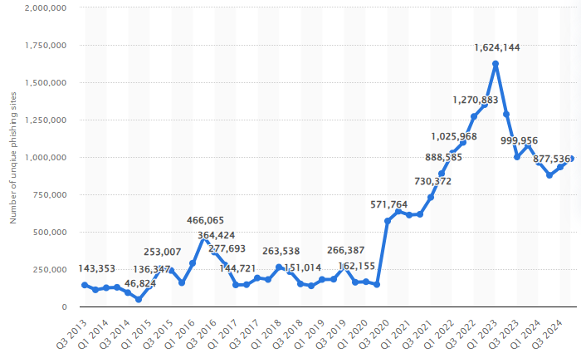

Common Phishing Types
The number of detected phishing sites across the world in each quarter from the 3rd quarter of 2013 to the 4th quarter of 2024 (Statista, 2025).
Notes:
Why Phishing Matters
Phishing, in cybersecurity, refers to an attempt by hackers to obtain a user's private information, such as passwords, credit cards, or bank account data (Burita et. al., 2021)
91% of system breaches start with phishing (Alkhalil et al.,2021)
$4M+ avg. cost per breach (Imber,2025)
3.4B spam emails daily; Google blocks 100M phishing emails/day
Project objectives
Detect phishing attempts from email/URL data
Compare effectiveness of 3 machine learning models (XG Boost, Random Forest, MLP)
Use DistilBERT for feature extraction

Slide 4

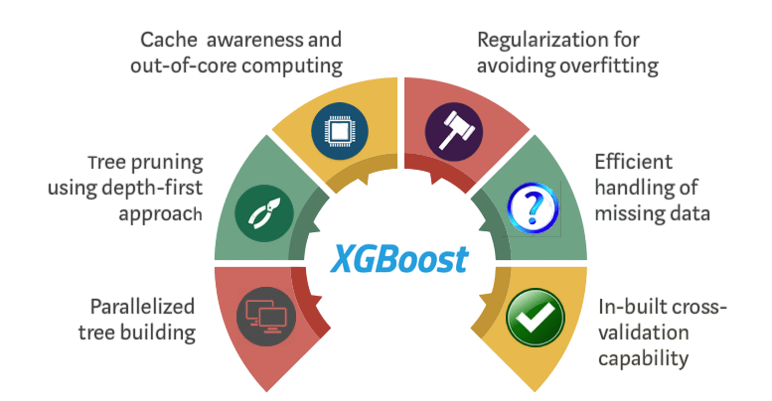
Why XG Boost ?
Notes:
-XGBoost (Extreme Gradient Boosting) is an optimized implementation of gradient boosting known for high performance and scalability (Shahrivari, Darabi, & Izadi, 2020)
-Builds an ensemble of weak learners, typically decision trees improving them iteratively to enhance performance (Shahrivari, Darabi, & Izadi, 2020)
-Scalable to large datasets suitable for both distributed systems and memory-constrained environments (Gu & Xu, 2022)
- Supports parallel and distributed computing, accelerating training and experimentation (Shahrivani, Darabi, & Izadi, 2020).
Regularization techniques reduce overfitting especially valuable in phishing detection (Gu & Xu, 2022)
Learning rate improves generalization on noisy or imbalanced datasets (Gu & Xu, 2022)
Flexibility allows for tailored optimization, making it ideal for phishing and email classification tasks (Gu & Xu, 2022)

Slide 5
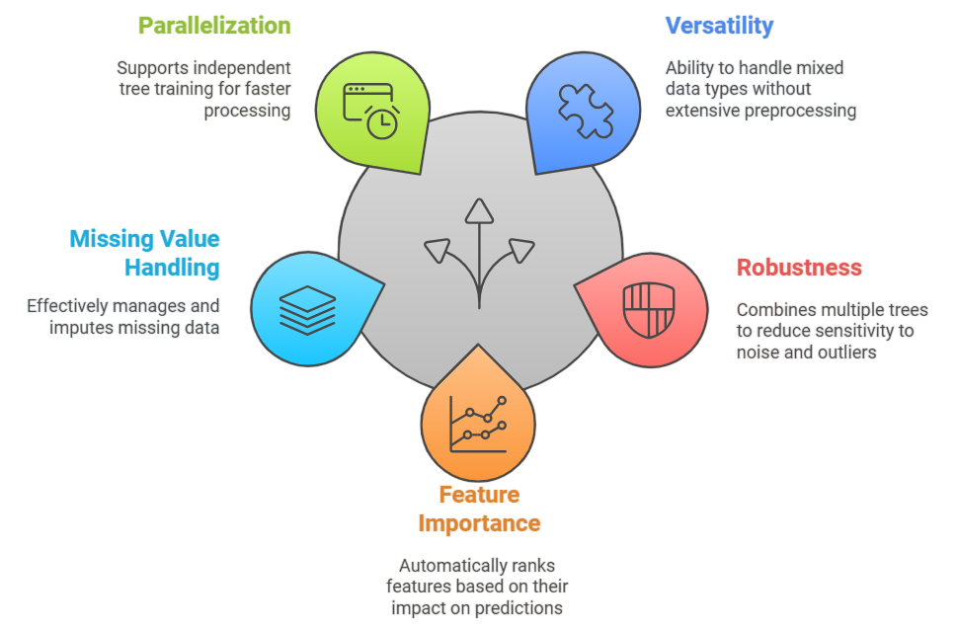
Why Random Forest ?
Notes:
Random forest is a supervised ML technique used in classification and regression problems (Dinesh et al.,2023)
Combines multiple decision trees tp increase accuracy and reduce overfitting through ensemble learning (Shahrivari, Darabi, & Izadi, 2020)
Performs well on large, imperfect data sets typical in phishing detection (Dinesh et al,, 2023)
Ensemble averaging reduces variance, as supported by the Central Limit theorem (Shahrivari, Darabi, & Izadi, 2020)

Slide 6

Why MLP ?
Adapts to new threats
Supports real-time detection with low false positives
Learns non-linear patterns, detects anomalies
Provides quick predictions after training
Works well with large input data
Notes:
MLP is a lightweight feedforward neural network widely used for classification and non-linear pattern recognition (Asani et al.,2024)
Capable of extracting features ,identifying anomalies, and defining non-linear decision boundaries (Reddy, 2023).
Especially suited for recognizing sophisticated phishing techniques that evade simpler models (Reddy, 2023).
Learns from updated datasets over time—improves accuracy and reduces false positives (Asani et al., 2024)
Supports real-time analysis, which is crucial in phishing detection (Asani et al., 2024).
Effective with proper parameter tuning and training on relevant phishing datasets (Reddy, 2023)

Slide 7
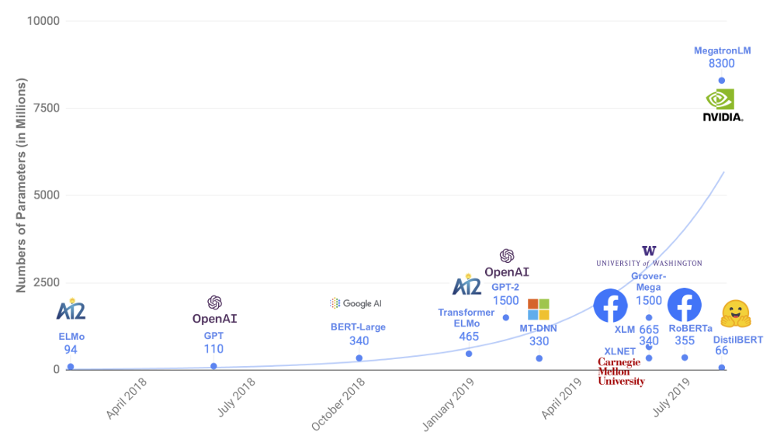
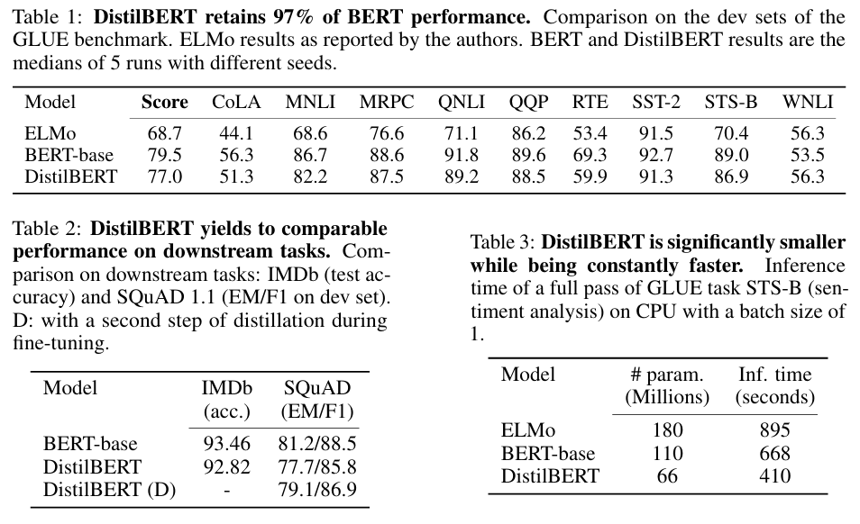
Feature Extraction Using DistilBERT
40% smaller, 60% faster than BERT
97% of BERT’s performance
Extracts semantic features from phishing emails/URLS
Notes:
ELMo: Introduced in March 2018 by Peters et. al., courtesy of the University of Washington
Embeddings from Language Models (ELMo)
Derived from a bidirectional LSTM
1802.05365v2
BERT: Introduced in May 2019 by Google AI
Bidirectional Encoder Representations from Transformers
uses a "masked language model" (MLM) and bidirectional transformers
DistilBERT: Introduced by Hugging Face in 2019, with the final version of their paper being submitted in March 2020.
Bert, but smaller and faster.
40% the size, 60% faster, and 97% of the performance
Sanh et. al. DistilBERT, a distilled version of BERT: smaller, faster, cheaper, and lighter
We will use DistilBERT to extract semantic features from phishing emails

Slide 8
Datasets Used
I don't see a requirement for mentioning datasets in section B of the proposal pdf. Since there aren't any visuals involved, do we just want to skip this? Up to y'all.
~Nathan

Slide 9


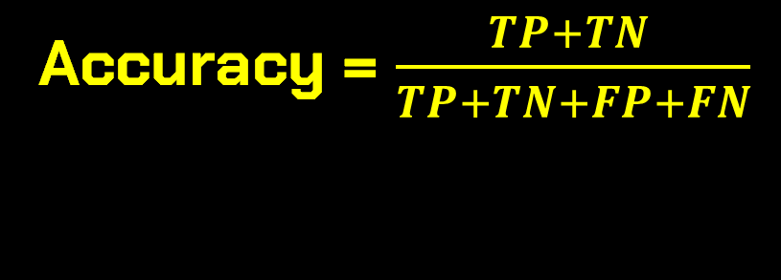
Evaluation Metrics
Accuracy = $\frac{TP+TN }{TP+TN+FP+FN}$
False Positive Rate (FPR) = $\frac{FP}{FP+TN}$
False Negative Rate (FNR) = $\frac{FN}{FN+TP}=1 −Recall$
Key: TP=True Positive, TN=True Negative, FP=False Positive, FN=False Negative
Notes:
Accuracy: Measures the overall correctness of predictions
False Positive Rate: Measures how often a legitimate is incorrectly flagged
False Negative Rate: Measures how often a phishing email is missed by the model
Processing Latency is also evaluated , which is the time (measured in milliseconds) that it takes the model to analyze incoming data and produce a classification result. This will also be utilized by comparing the total testing time for each model , this is important for real-time phishing detection

Slide 10


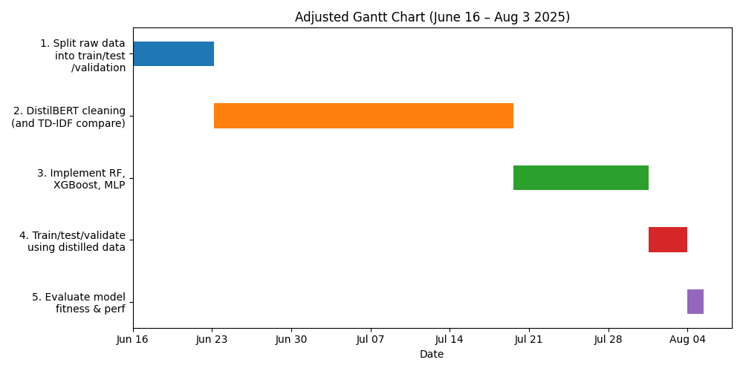

Timeline & Feasibility

Slide 11

References
Used in Presentation:
Sanh, V., Debut, L., Chaumond, J., & Wolf, T. (2019). DistilBERT, a distilled version of BERT: smaller, faster, cheaper and lighter. arXiv preprint arXiv:1910.01108.
Devlin, J., Chang, M. W., Lee, K., & Toutanova, K. (2019, June). Bert: Pre-training of deep bidirectional transformers for language understanding. In Proceedings of the 2019 conference of the North American chapter of the association for computational linguistics: human language technologies, volume 1 (long and short papers) (pp. 4171-4186).
Owen, A., & White, E. (2024). Evaluating the Effectiveness of AI-Based Phishing Detection in IoT Communication Protocols.
Morde, V. (2019, June 23). XGBoost algorithm: Long may she reign! Medium. https://medium.com/data-science/https-medium-com-vishalmorde-xgboost-algorithm-long-she-may-rein-edd9f99be63d
SitePoint. (2025). Random Forest algorithm in machine learning. https://www.sitepoint.com/random-forest-algorithm-in-machine-learning/
Gu, J., & Xu, H. (2022, January). An ensemble method for phishing websites detection based on xgboost. In 2022 14th international conference on computer research and development (ICCRD) (pp. 214-219). IEEE.
REDDY, K. T. (2024) Enhancing Phishing Detection Through Multilayer Perceptron in Cybersecurity.
Shahrivari, V., Darabi, M. M., & Izadi, M. (2020). Phishing detection using machine learning techniques. arXiv preprint arXiv:2009.11116.
Potential Data Sets:
GitHub - rokibulroni/Phishing-Email-Dataset: A comprehensive dataset of phishing and legitimate emails curated for cybersecurity research and applications. This dataset is designed to help researchers, data scientists, and cybersecurity professionals develop, train, and evaluate models for phishing detection, email filtering, and threat analysis.
Tamal, M. (2023). Phishing Detection Dataset [Data set]. Mendeley Data. https://data.mendeley.com/datasets/6tm2d6sz7p/1

